Slide 1
Distance and displacement graphs

Slide 2
Revise scalar and vector
A Scalar is a quantity that does not need direction to describe/define it.
[examples- energy (J), time (s), mass (kg) – these all can not be negative]
Distance cannot be negative, and never decreases. Distance is a scalar quantity, or a magnitude. Displacement... It can be negative, zero, or positive. Directed distance does not measure movement, it measures the separation of two points, and can be a positive, zero, or negative vector. Distance – Wikipedia
A Vector is a quantity that does need a direction to define/describe it.
[examples – displacement, velocity, force, acceleration, momentum - these all can be zero, positive or negative]

Slide 3
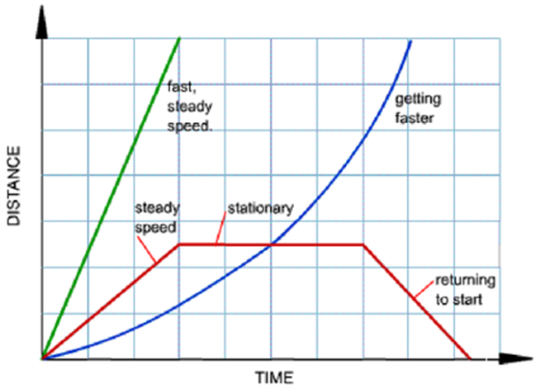
Distance and Displacement graphs
Recall the video from yesterday about a journey that returned to it’s starting point.
It showed a distance time graph like the one in red.
Recall the statement from the previous slide
Distance is a scalar- it can not be negative
There is a great deal of incorrect information on the internet regarding graphing return journeys as distance time graphs.
Can you identify the direction referencing system used in the graph?

Slide 4
Frames of reference for direction (how we can describe direction)
Any system that can show different directions can be used.
once a quantity is described with a direction it is now a vector and can be positive, negative or zero.
Examples of direction systems (conventions- agreed upon)
Left or right – frame of reference from a point or position (One direction is positive, the other negative)
Up or down (same as left or right)
X and y axis (right is positive, left is negative)
Compass bearings (North accepted as 0 degrees, 360degrees to return from all directions to North)

Slide 5
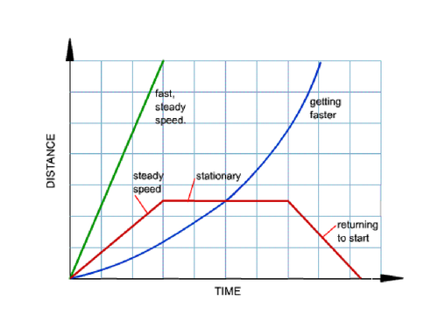
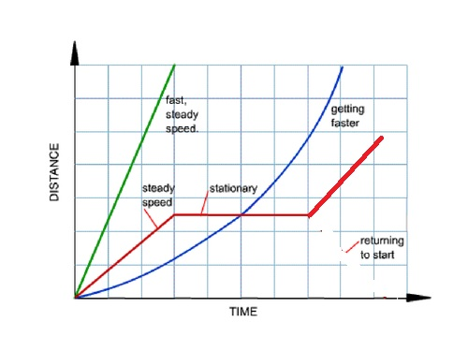
Distance and Displacement graphs
From the information in the previous slides, it can be seen that the way the return journey is shown has the distance decreasing along the y axis.
This is indicating the direction of the distance from home and the total distance travelled from home (ends up being 0).
The graph should have been labelled a displacement time graph or been shown like the one below.
Beware the internet!

Slide 6
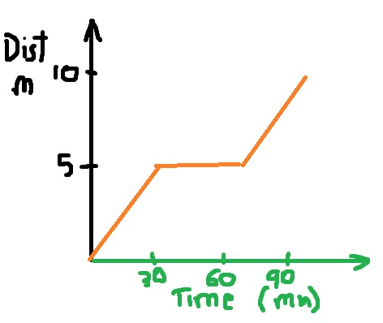
Describing and graphing Journeys
We need to be able to describe a journey from a graph and be able to graph a described journey.
Draw a distance time graph of the journey described in below:
From home running 5km from A to B – 30 minutes
Waiting at friends house B to C – 30 minutes
Running home 5km C to D – 30 minutes

Slide 7

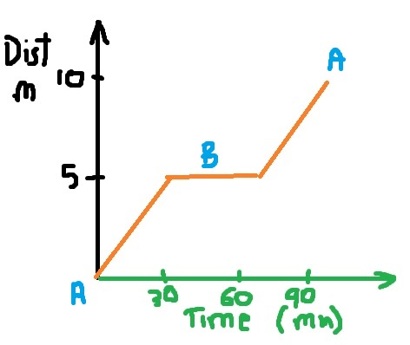
It must be understood that if we were only given the distance time graph, all we can say is that we travelled 5km, waited 30 min and travelled 5 more km for a total of 10km.
We can not say anything about direction.
This is because distance is a scalar quantity and direction is not needed to describe it.
If there is some other reference such as A and B from the description, we can better describe the journey.

Slide 8
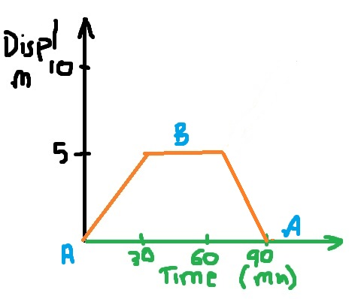
Describing and graphing Journeys
Graph the displacement of the person’s journey from the previous example.

Slide 9
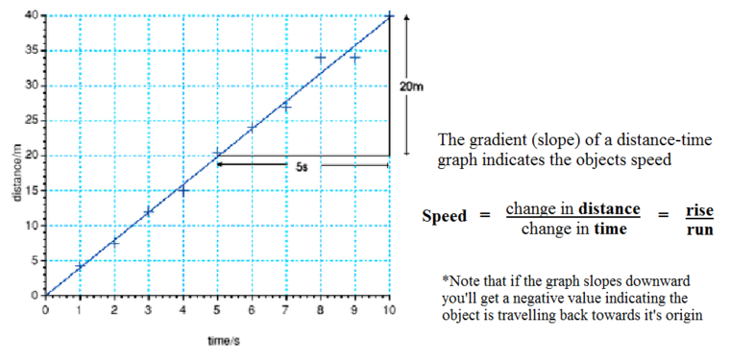
Describing and graphing Journeys
Calculate speed and velocity from graphs
Go back to the last two graphs and calculate speed or velocity for each segment.

Slide 10
Describing and graphing Journeys
Complete the graphing and description tasks on this worksheet. Correcting any incorrect concepts.

